Slide 1
IG Network
Anastasia Chatzidimitriou
Senior Researcher
Institute of Applied Biosciences, CERTH
Thessaloniki, Greece
March 28-19, Bethesda

Slide 2
Aims of the Network
promote and advance the determination of IGHV gene mutational status in CLL for diagnostic and prognostication purposes
standardized and consistent methods in immunology & the bioinformatics tools
reliable & comparable results among different institutions ➔ patient care
CERTIFICATION OF IMMUNOGLOBULIN GENE
SEQUENCE ANALYSIS IN CLL
Notes:
educating the hematological community about the need to apply
based on the state-of-the-art
most innovative
in Europe, and elsewhere
ultimately

Slide 3
Structure of the network
Certifying Centers
Frederic Davi, Paris, France
Kostas Stamatopoulos, Thessaloniki, Greece
Paolo Ghia, Milan, Italy
Anton Langerak, Rotterdam, The Netherlands
Sarka Pospisilova, Czech Republic
Richard Rosenquist, Uppsala, Sweden and Nordic countries
Stephan Stilgenbauer, Ulm, Germany
Reference Centers

Slide 4
Certification of IG Gene Sequence Analysis
Addressed to
recently introduced novel diagnostics
all labs performing diagnostics for patients with CLL
need official certification of quality control for applied methodologies
Certification rounds - 3 phases
Notes:
a procedure for
to ensure the
and need reassurance about the quality of results
This initiative is supervised by the
Articulated in

Slide 5
Rounds of certification
phase 1 | Participation form and survey of
current practices

Slide 6
https://barcelo.eventsair.com/eric-ig-certification/igparticipationform/Survey/Register

Slide 8
phase 2 | Laboratory and bioinformatics analysis
quality control material preparation [genomic DNA from 5 CLL cases of diverse IGHV gene mutational status] – and shipment to the labs
Labs are informed about the shipment details and all the necessary guidance in order to carry out the analysis
online results form within 3 months
Notes:
The certifying centre will prepare the
which must be sent within
The analysis will be completed through the submission of an

Slide 9
phase 2 | Guidance
Technical and report quidelines file
IG reports examples file

Slide 10
phase 3 | Evaluation & decision
analysis per se and IG sequence interpretation.
Successful laboratories → certificate and a letter summarizing their performance
Unsuccessful laboratories → reapply at the next round and necessary guidance
Notes:
in terms of both
will assess the results
will be provided with a
will be asked to be provided with

Slide 11
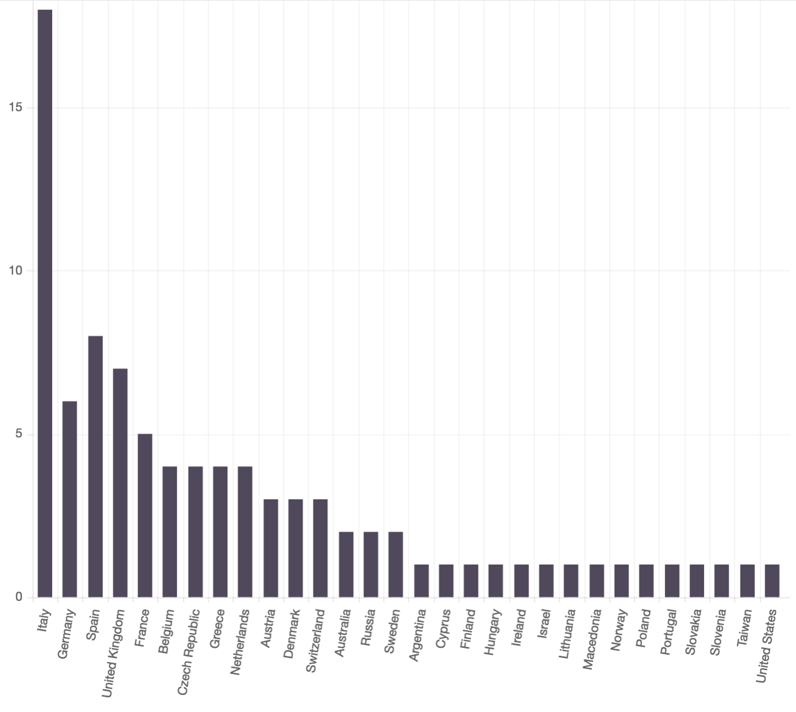
Certified centres per country – all rounds
4 certification rounds
90 certified centres
30 countries

Slide 12
Expression of interest - participation
all year long
Certification rounds
2 times a year

Slide 14
IG Network
Anastasia Chatzidimitriou
Senior Researcher
Institute of Applied Biosciences, CERTH
Thessaloniki, Greece
March 28-19, Bethesda

