Slide 1
Immunogenetics dealing with challenges with tailored bioinformatics solutions
Anastasia Chatzidimitriou
Senior Researcher
Institute of Applied Biosciences, CERTH
Thessaloniki, Greece

Slide 2
Immunogenetics dealing with challenges with tailored bioinformatics solutions
Anastasia Chatzidimitriou
Senior Researcher
Institute of Applied Biosciences, CERTH
Thessaloniki, Greece

Slide 3
Basic immunogenetic characteristics of
Chronic lymphocytic Leukemia

Slide 4
Mutations in Immunoglobulin genes
Time from diagnosis
Hamblin et al, 1999
Damle et al, 1999

Slide 5
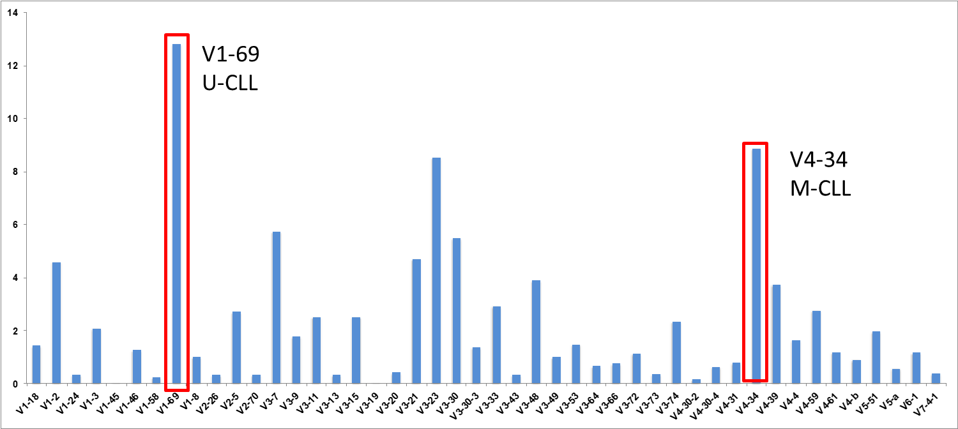
Biased IG repertoire
Stamatopoulos et al. Blood 2005 | Stamatopoulos et al. Blood 2007 | Murray et al. Blood 2008 |
Hadzidimitriou et al. Blood 2009 | Kostareli et al. Leukemia 2009 | Agathangelidis et al. Blood 2012

Slide 6
Stereotyped B cell receptors
n=7424
Possibility of two different B clones with the same immunoglobulin
10⁻¹²
30% of all CLL
different stereotypes
20 major subsets
Stereotypy in CLL
Common antigens

Slide 7
ERIC/IMGT CLL-DB
2018
Belfast
Uppsala
Moscow
Kiel
Copenhagen
Bournemouth
London
Rotterdam
Rochester, MN
Paris
Ulm
Brno
Novara
Belgrade
New York
Turin
Padova
Milan
Barcelona
Montpellier
Athens
27 centers
31000 patients

Slide 8
Analysis challenges
in CLL research

Slide 9
1. Stitching of the two reads
2. Sequence quality
3. Repertoire analysis
4. Stereotyped Subsets detection
5. SHM characteristics
What about NGS?

Slide 10
Bioinformatic solutions @ INAB
A cascade of in-house developed algorithms implemented in the Galaxy platform
The process results to a batch of easy-to-handle files containing fundamental data on Ig gene expression and associations as well as characteristics of the somatic hypermutation mechanism
.
Institute of Applied Biosciences,
CERTH, Thessaloniki

Slide 11
Low throughput
Repertoire Analysis

Slide 12
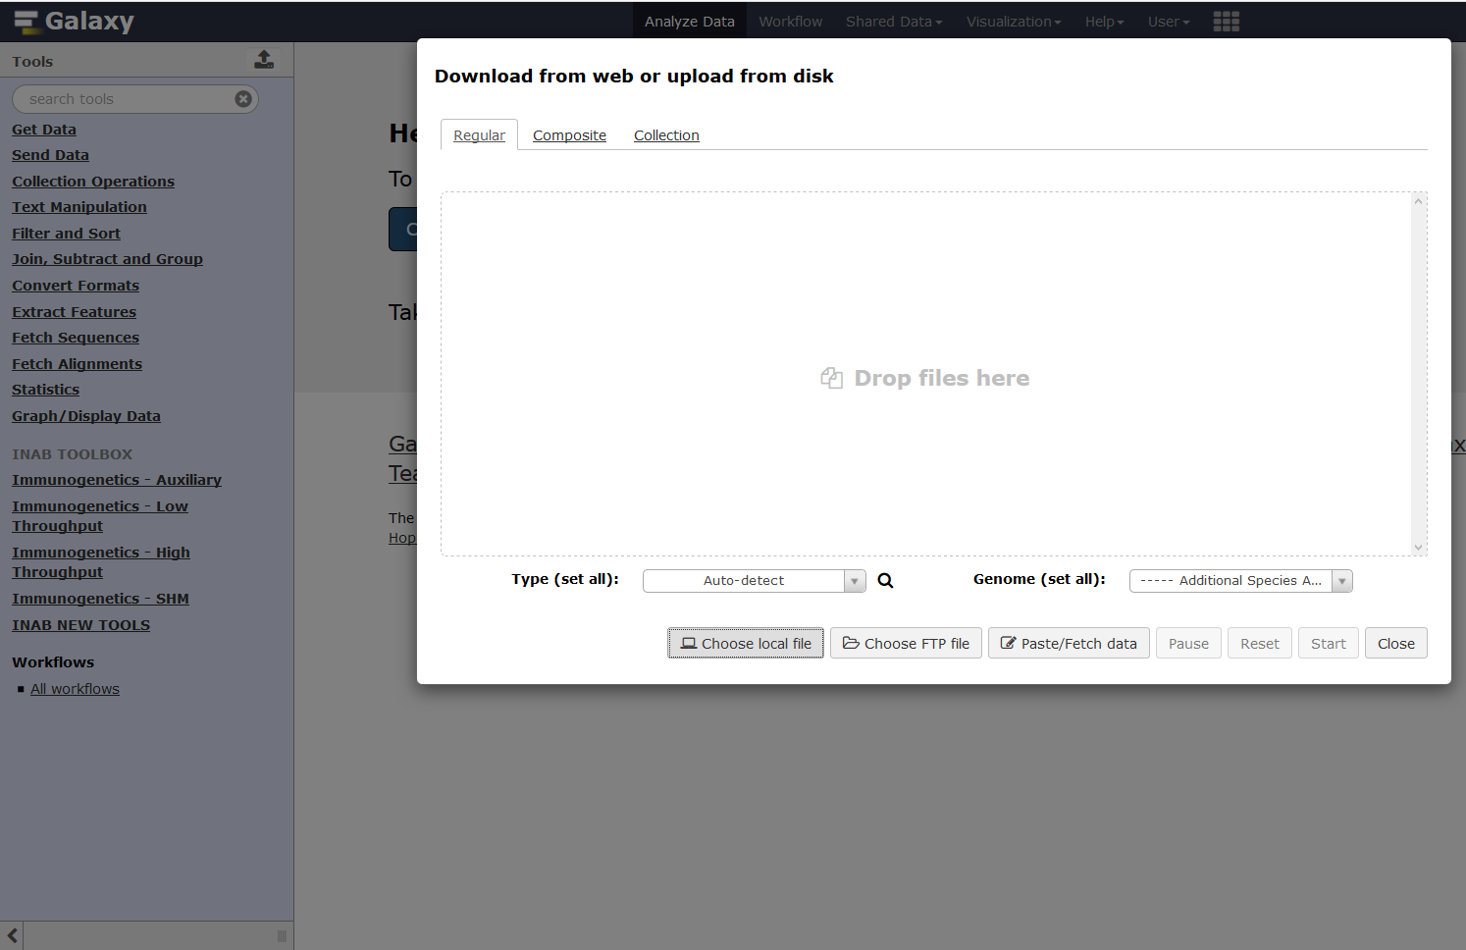
Step 1
Upload your files
.

Slide 13
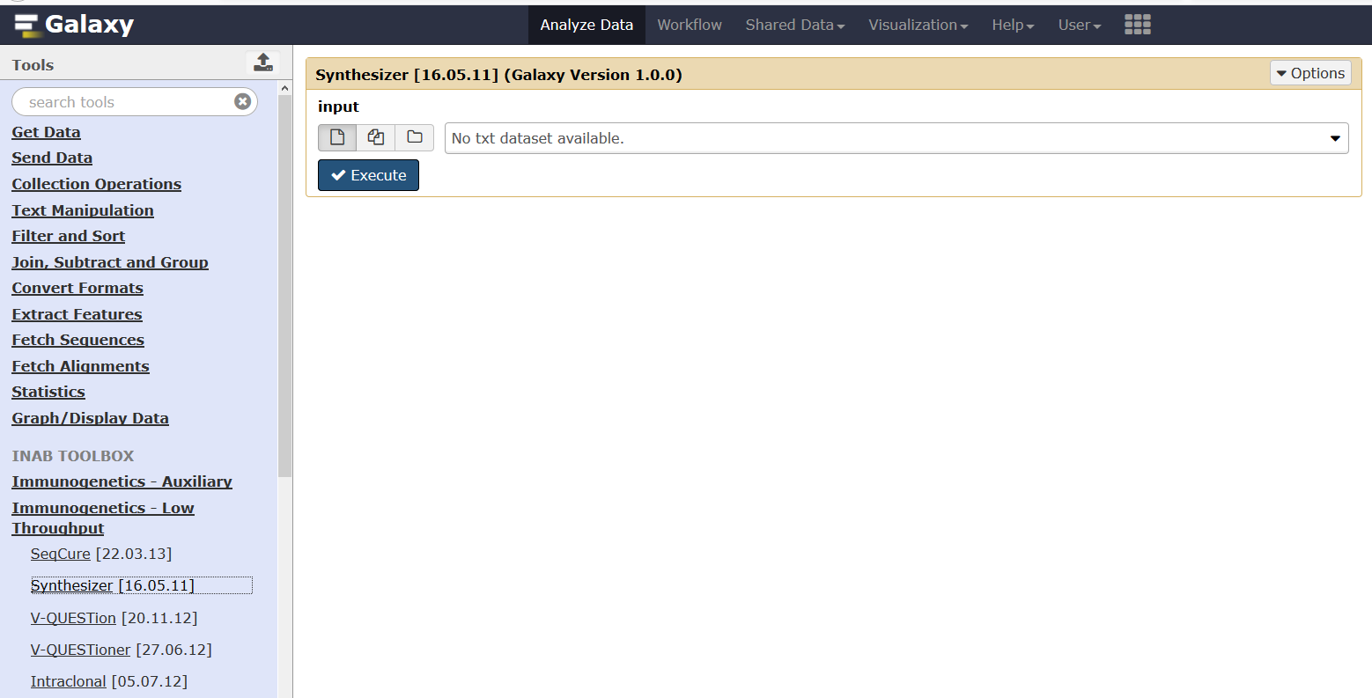
Step 2
PreAnalysis: Sequence curation and annotation
Synthesizer tool: Generates the complete sequence of an Ig gene rearrangement combining the forward and reverse primer sequencing reads

Slide 14
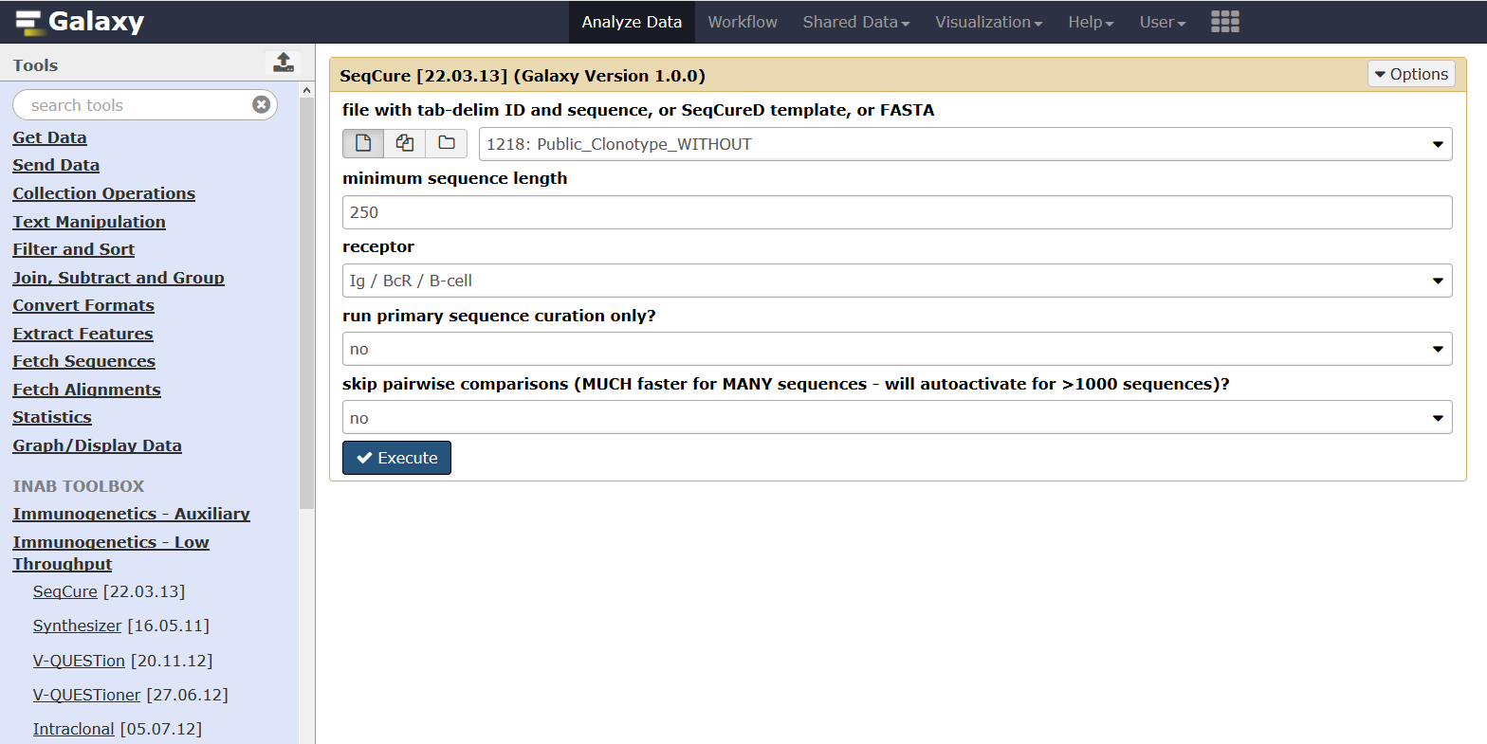
Step 2
PreAnalysis: Sequence curation and annotation
SeqCure tool
- short sequences - sequence ambiguities
- sequence and/or ID duplications - sequence overlaps

Slide 15
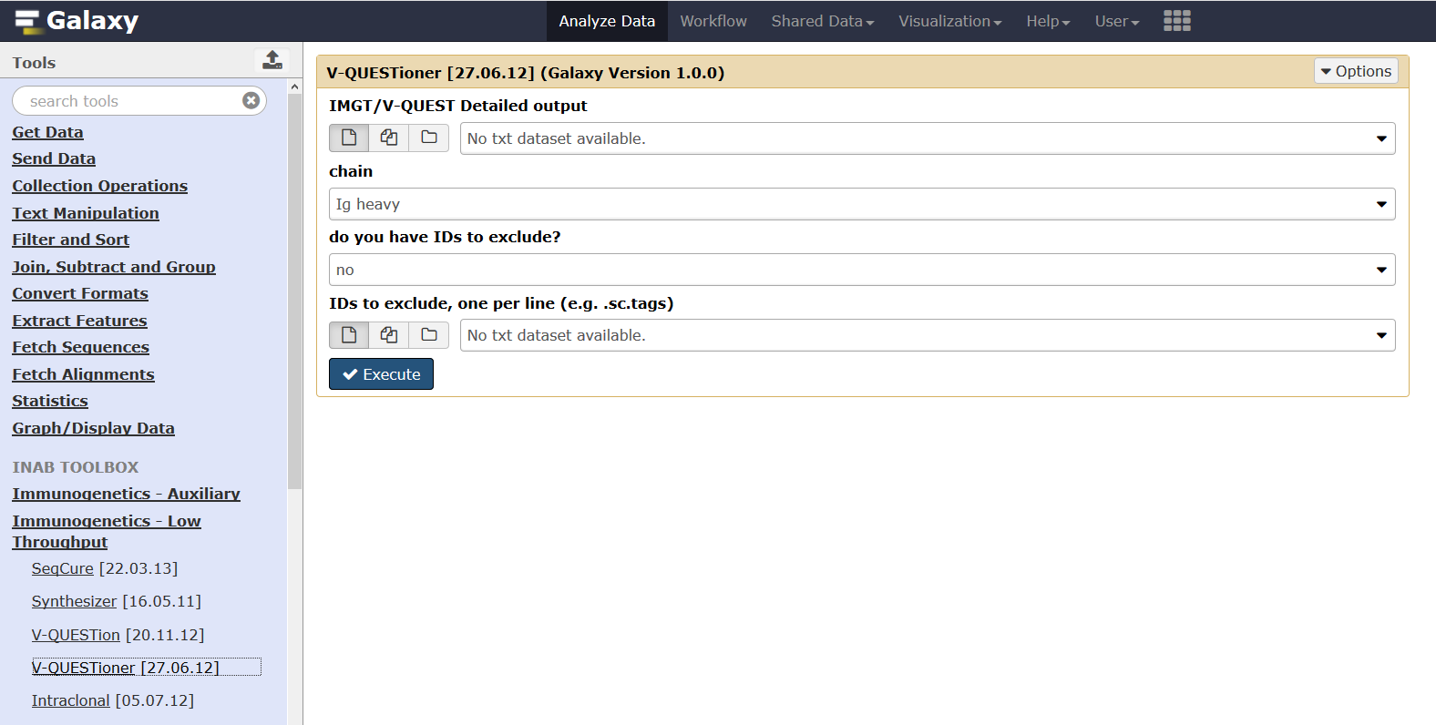
Step 3
Analysis: Interpetation, data mining, graphical representations
V-QUESTioner: analysis of large datasets of Ig gene rearrangements from cases sharing unifying characteristics (e.g same disease)
It extracts valuable information from the IMGT/V-QUEST “detailed analysis” of each rearrangement, regroups it and organizes it in spreadsheets, informative on specific features of the rearrangements.
Sequence alignment (both nu and aα)
IG gene repertoire and associations
SHM analysis
CDR3 analysis

Slide 16
b. NGS data analysis pipeline
from sequences to clonotypes

Slide 17
Workflow
1. Stitching process
2. Sequence annotation
3. Clonotype computation & repertoire extraction

Slide 18
Stitching process
Algorithm for synthesis of the two anti-parallel reads from TRs/IGs produced by paired-end NGS protocols
Quality assessment of the raw and stitched sequences based on certain parameters
Error code | Error description
1 | not enough continuous match
2 | not enough overlap
3 | low mean quality
4 | short length
5 | high percentage of low quality nts
6 | high percentage of low quality nts before CDR3 anchor
7 | ins/del
FASTA output of stitched/ filtered-in sequences

Slide 19
Sequence annotation IMGT/High-VQUEST tool
Stitched/filtered-in sequences in FASTA format from the stitching algorithm annotated via IMGT/High-VQUEST tool
Summary file from IMGT/High-VQUEST output serves as an input for the next step

Slide 20
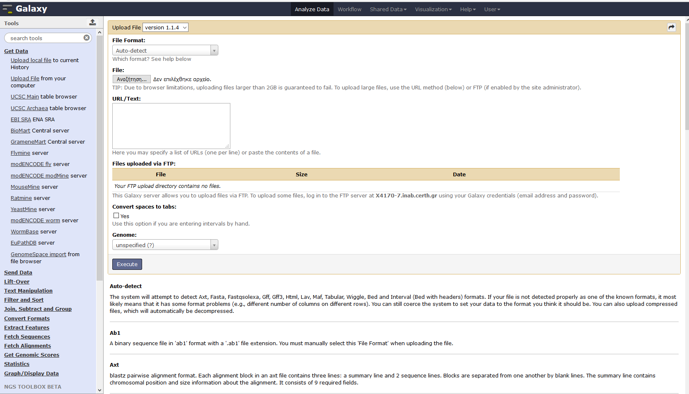
Clonotype computation and repertoire extraction
1st step: Upload dataset
IMGT/HighVQUEST Summary file

Slide 21
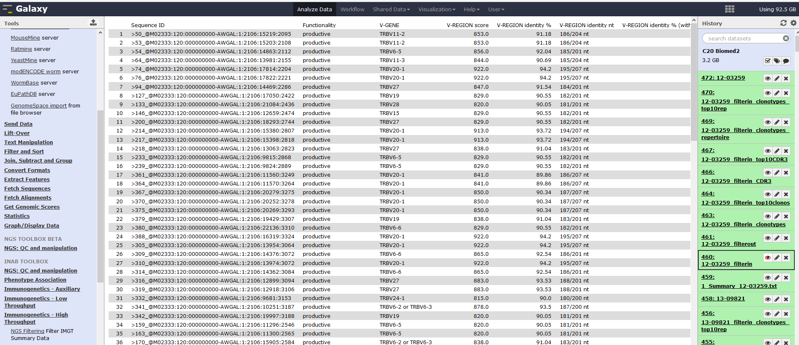
2nd step: Sequence filtering

Slide 22
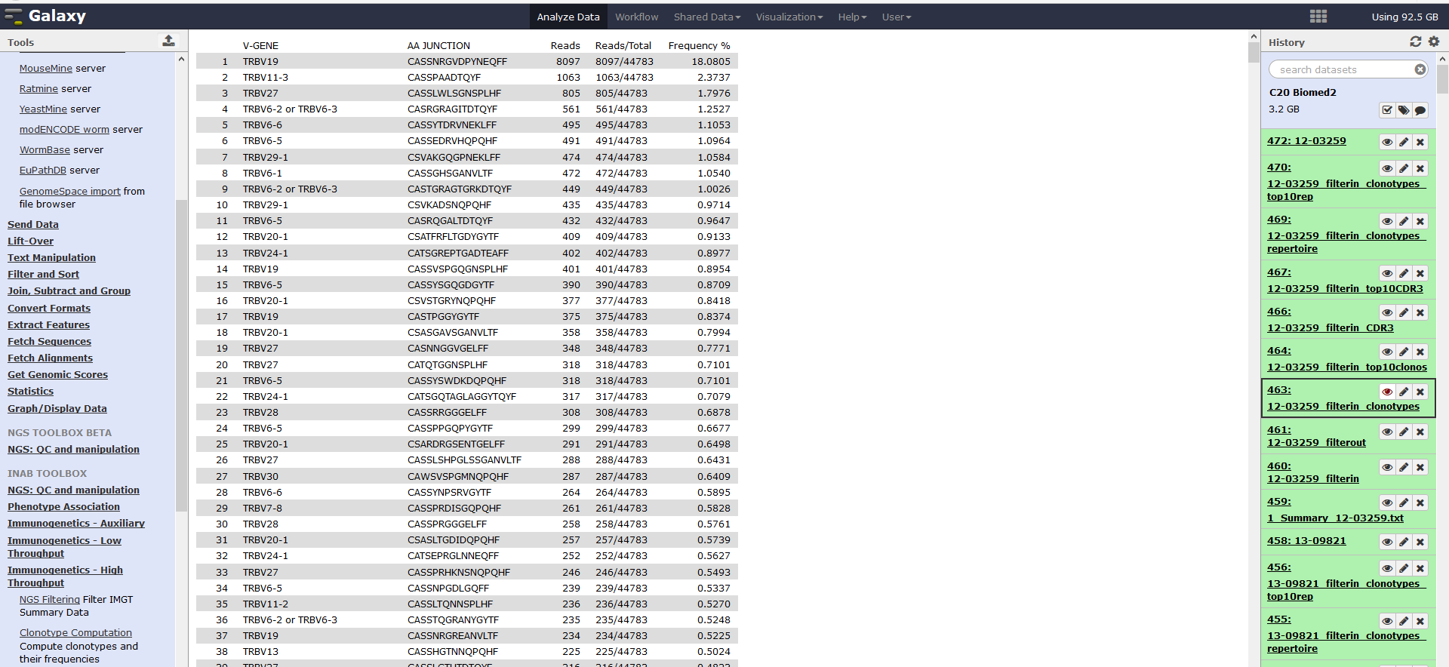
3rd step: Clonotype computation
This tool computes clonotypes → unique pairs of V-genes and CDR3, and their frequency.
Total filtered-in sequences as an input

Slide 23
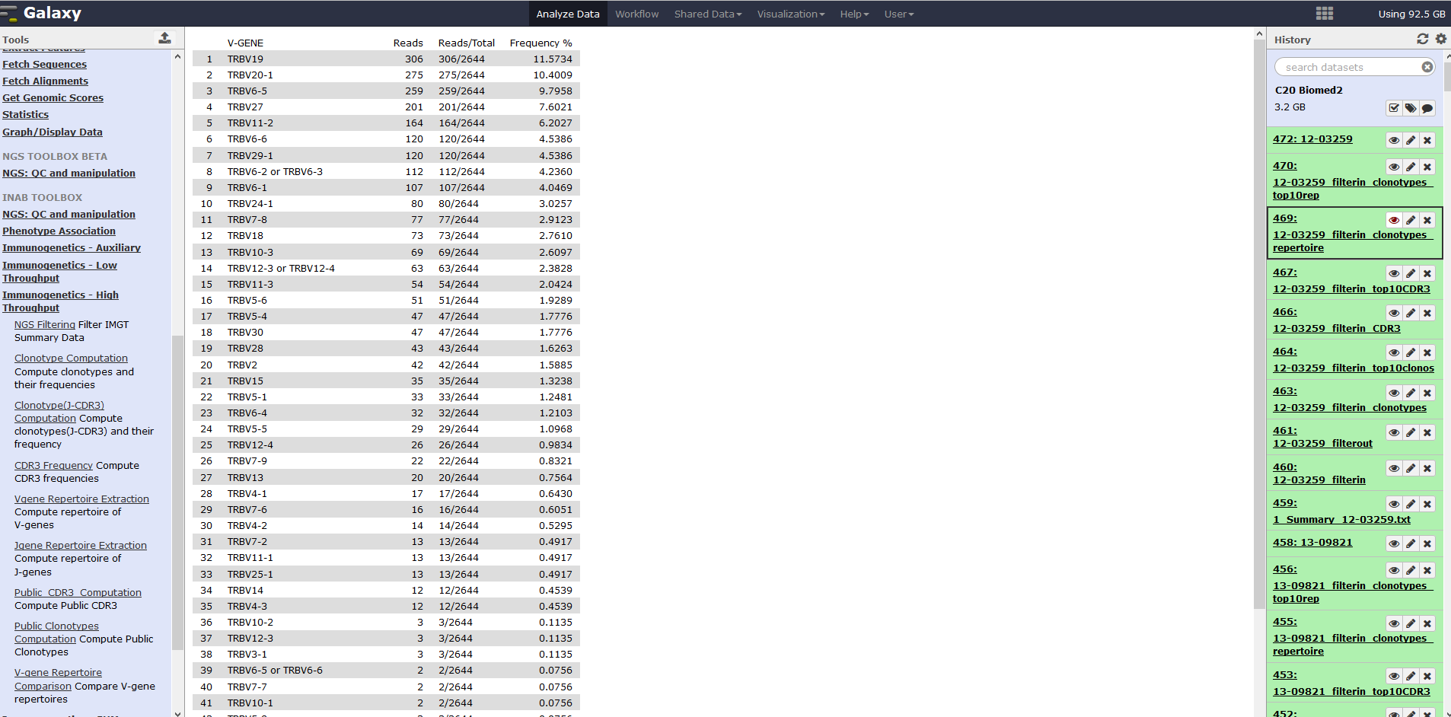
4th step: V gene repertoire extraction
This tool computes the repertoire of V-genes, i.e. , the number of clonotypes using each V-gene over the total number of clonotypes.

Slide 24
Tools for pairwise or multiple comparisons are also available:
Public clonotypes: This tool computes the public/common Clonotypes among a number of patients along with their frequencies for each patient
V-gene repertoire comparison: This tool produces a union of all patients' V-gene repertoires and computes the mean frequency of each V-gene.

Slide 25
Stereotyped Subsets detection tools
1. PatteDA
- Pattern discovery method
- Assignment is based on the existence of shared sequence patterns within the VH CDR3
2. AssignSubsets
- Probabilistic Bayes model
- Assignment is based on evaluating sequence features against each major subset
Notes:
Τώρα θα περάσω στο δεύτερο κομμάτι της παρουσίασης που είναι οι μέθοδοι που έχουμε αναπτύξει για τη μελέτη της στερεοτυπίας.
Η πρώτη μέθοδος ονομάζεται τειρεσίας και είναι μια pattern discovery μέθοδος η οποία βασίζεται στην αναγνώριση κοινών αμινοξικών μοτίβων στην περιοχή CDR3 μεταξύ διαφορετικών ασθενών.
Η δεύτερη μέθοδος ονομάζεται AssignSubsets και είναι ένα μοντέλο ... Το συγκεκρμένο εργαλείο αναγνωρίζει στερεότυπες αναδιατάξεις μόνο όμως για κάποιο από τα 19 κύρια υποσύνολα.

Slide 26
1. PatteDA tool
Sequence clustering based on CDR3
common patterns
- amino-acid identity & similarity
- CDR3 length
- CDR3 offset (position of the motif within CDR3)
Parameters
alluding to
stereotypy

Slide 27
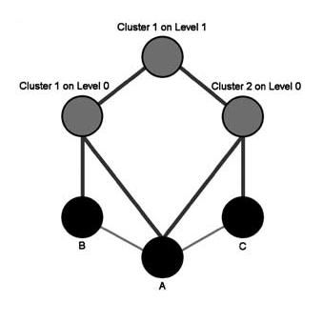
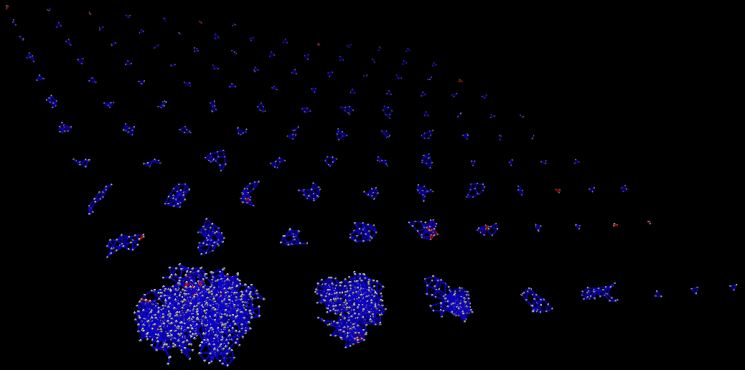
1. PatteDA tool
The existence of common amino-acid patterns between ground level clusters led to their grouping in clusters at progressively higher levels of hierarchy.
High-level clusters reflect more distant sequence relationships among clustered cases offering a comprehensive overview of the CDR3 ‘landscape’.

Slide 28
1. PatteDA tool
Clusters/Subsets of cases carrying stereotyped CDR3s – accented in CLL
Darzentas et al.; Leukemia. 24:125-132. 2009
important application:
CDR3s of published IG rearrangements of specified specialty can be added, and if clustered to provide annotation to other cluster members

Slide 29
2. AssignSubsets tool
Core features
identical VH CDR3 length, a critical determinant of the structure of the antigen (Ag) recognition loop
same IGHV gene phylogenetic clan, implying significant sequence similarity of IGHV genes belonging to the same clan and thus sharing common ancestry
mutational status of the rearrangement.
Secondary
features
relative frequency of rearranged IGHV and IGHJ genes, useful in subsets where the IGHV genes utilized are unequally represented
(prime example is subset #1)
amino acid frequencies at any given position within the VH CDR3.
Notes:
Η λειτουργία του βασίζεται στην εξέταση συγκεκριμένων ανοσογενετικών χαρακτηριστικών που διακρίνονται σε 2 κατηγορίες: τα βασικά που είναι τα ... Και τα δευτερεύοντα που είναι ...
Η διαφορά τους είναι ότι αν η αναδιάταξη δεν πληρεί κάποια από τις βασικές προυποθέσεις δε θα μπει σε κάποιο κύριο υποσύνολο ενώ τα δευτερεύοντα χαρακτηριστικα καθορίζουν το σκορ που θα πάρει το assignment.

Slide 30
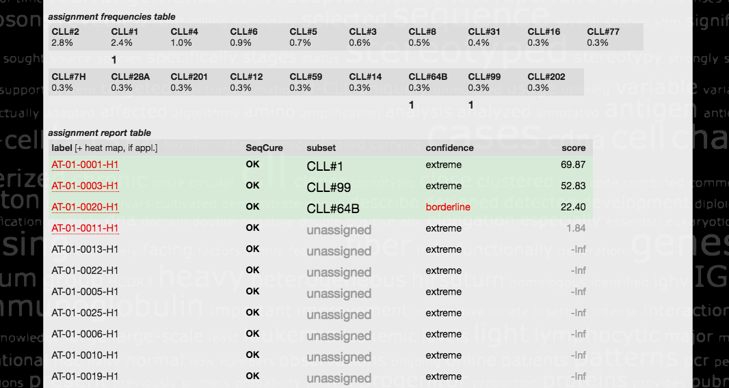
2. AssignSubsets tool
Notes:
Στην εικόντα φαίνεται το αποτελέσμα που δίνει το εργαλείο.
Αρχικά δίνεται η λίστα με τα κύρια υποσύνολα και το ποσοστό κάθε υποσυνόλου με βάση την τελευταία μας μελέτη.
Από κάτω δίνεται η κατάταξη κάθε αλληλουχίας...

Slide 31
SHM characteristics

Slide 32
CorrMut tool
algorithm to identify patterns of recurrent replacement mutations
scanning the V-region for key positions
that possibly cooperate in antigen recognition
Pinpoints the positions of the recurrent mutations along the IG rearrangement sequence

Slide 33
CorrMut tool
- Scores patterns of recurrent mutations based on:
Number of mutations participating in the pattern
Number of sequences carrying the pattern
Nature of the mutations
- Arranges recurrent mutations by popularity order and their partners

Slide 34
challenges and solutions
analysis challenges research question in CLL
Common requirements in
normal B cell ontogeny
immunodeficiency
autoimmunity
lymphomagenesis

Slide 35
Immunogenetics dealing with challenges with tailored bioinformatics solutions
Anastasia Chatzidimitriou
Senior Researcher
Institute of Applied Biosciences, CERTH
Thessaloniki, Greece

